Slide 1

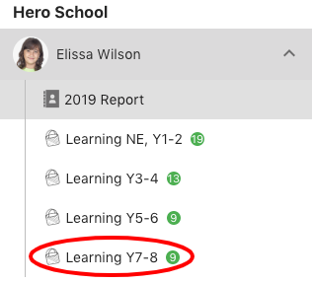
Welcome to Hero!
Click on the grey arrow to view different slides
This digital report provides you with personalised information about your child’s progress and achievement in Reading, Writing and Number. Information about how to read this is contained in the following slides.
In addition, we also report on the wider curriculum and key competencies. Posts on these subjects can be found by clicking on the page showing the Year level your child is currently in.

Slide 2
Progression Through Goals
Literacy and Numeracy are important foundation skills for children.
Primary and intermediate schools focus on these because your child needs to have sound Reading, Writing and Maths skills to be able to do well in every area of learning at school and in life.
Teachers use many different ways to find out where your child is at. This includes a range of formal tests and assessments, watching your child working in the classroom, talking with your child about their learning and having your child assess their own and other’s work.
This page summarises your child’s progress through goals. The following slide explains what you will see.

Slide 3
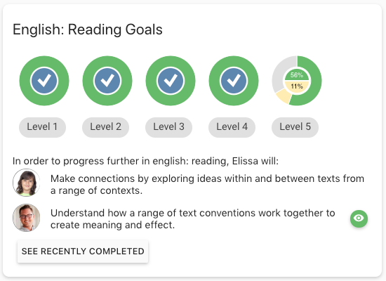
Understanding The Data
The subject
Radial dials showing the goals your child has completed (green) and the goals they are currently working on (buff).
A pop up showing the goals to be completed at each level. Click to view.
Goals your child is currently working on, set by teachers or the child.
Evidence related to the goal.
Click to view.
Goals your child has recently
completed. Click to view.

Slide 4
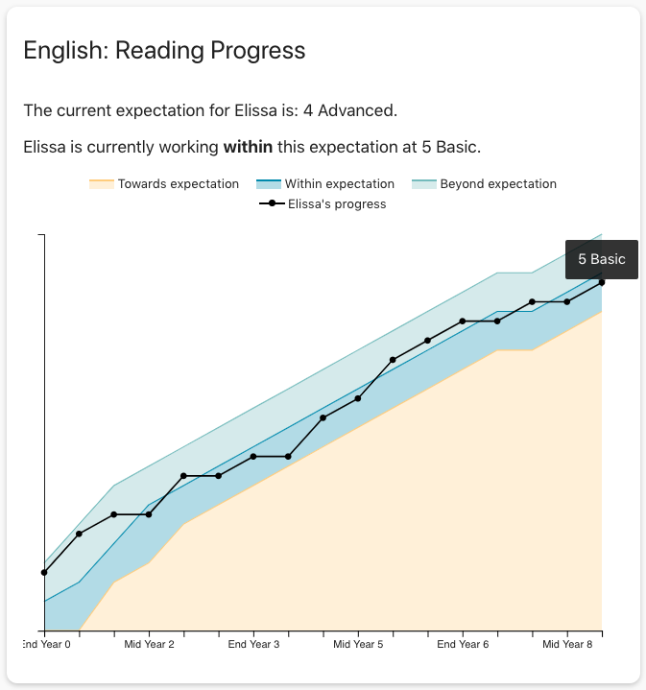
Understanding The Data
The curriculum level your child is expected to be working within based on their school year level.
The subject
A description of how your child is progressing towards the school expectation and the level they are currently working within.
A chart showing your child’s progress over time. Click to view. You can see the level each dot represents by clicking on it.

Slide 5
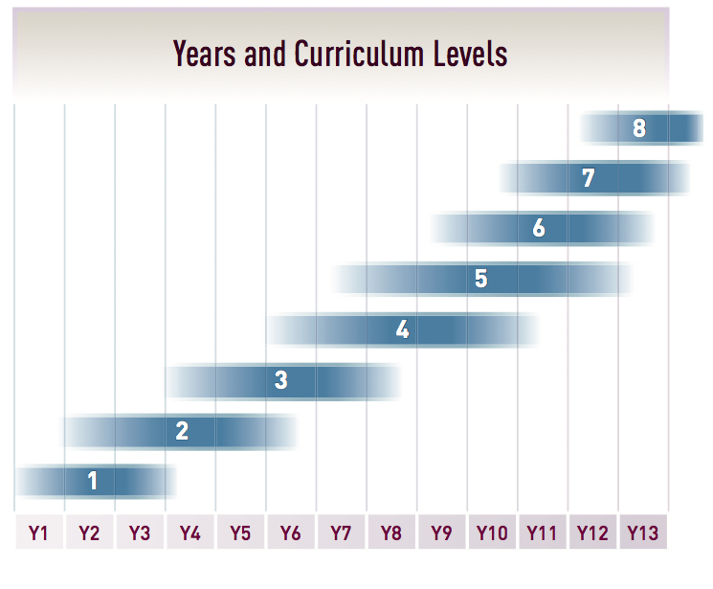
The New Zealand Curriculum Levels
This diagram shows how curriculum levels typically relate to years at school. Many students do not, however, fit this pattern. They include those with special learning needs, those who are gifted and those who come from non-English- speaking backgrounds. Students learning an additional language are also unlikely to follow the suggested progression: level 1 is the entry level for those with no prior knowledge of the language being learned, regardless of their school year.
NZ Curriculum

Slide 6
Key Competencies
The Five Key Competencies are identified in the New Zealand Curriculum and are integral to your child’s learning. Your child will be exploring these capabilities across all subjects.
Managing self
Participating and contributing
Relating to others
Thinking
Using language, text and symbols
We want to help your child to become a capable and lifelong learner. The aim of the key competencies is to give your child the skills to learn in any situation, including at home, participating in sport or cultural occasions as well as at school.

Slide 7
Supporting Your Child’s
Learning
Click on the links below to read information about how you can help your child at home.
Early years | Year One | Year Two | Year Three | Year Four
Year Five | Year Six | Year Seven | Year Eight
Click on the links below to read information in home languages.
Arabic | Chinese | Cook Island Maori | Dari | Hindi
Korean | Niuean | Samoan | Somali | Tagalog
Thai | Tokelauan | Tongan | Te Reo

